Slide 1
Week 1

Slide 2
Concepts to focus on
The PowerPoints for each week are the topics to focus on closely.

Slide 3
Organization of Text and Class
Andy Field organized his text to highlight the similarities between statistical tests.
This is useful for learning the basic analysis process.
Some of the details may differ between tests, but the steps are usually the same.
I plan to follow his ordering of concepts, but with a few minor deviations
I plan to emphasize the steps for conducting a data analysis a bit more than statistical concepts.
I plan to include a couple topics in this course which he placed further back in the text, but which are used a great deal in healthcare analyses.

Slide 4
Independent Variable

Slide 5
Dependent Variable

Slide 6
Categorical Variable

Slide 7
Binary Variable
Dichotomous variable

Slide 8
Nominal

Slide 9
Ordinal

Slide 10
Continuous Variable

Slide 11
Interval

Slide 12
Ratio

Slide 13
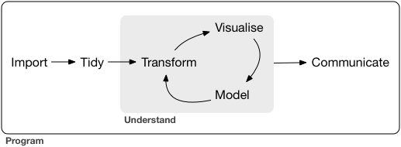
Analysis process

